Slide 1
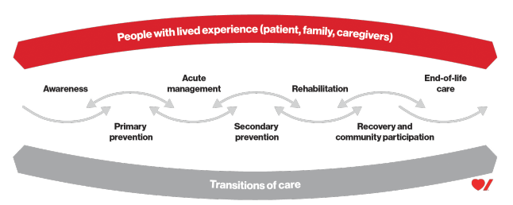
THE STROKE CARE NETWORK (SCN)
Since 2019 the SCN has worked to standardize and provide equitable access to evidence based stroke care along the patient journey.
The SCN Medical Director, Director, and Clinical Nurse Specialist provide leadership to guide clinical operations to implement and sustain rapidly advancing stroke best practice.
Our goal is exceptional stroke care without delay.
Notes:
The governance structure of this network includes:
Dr. Aleks Tkach – Medical Director, Vascular Neurologist MD FRCPC: Aleks has worked in Montana and Utah and has a passion of improving rural care.
Cory Bendall BHSC (RT) MPH - Operations Director, my background: I have a masters in Public Health and Health Promotion and started my career in acute care, transport and rehabilitation as a Respiratory Therapist.
Pamela Hruska – Masters Prepared Critical Care RN - Network Clinical Nurse Specialist: Pam guides systems development through policy review, education, and research support.
Aleks - Network Model - why this works!

